Slide 1



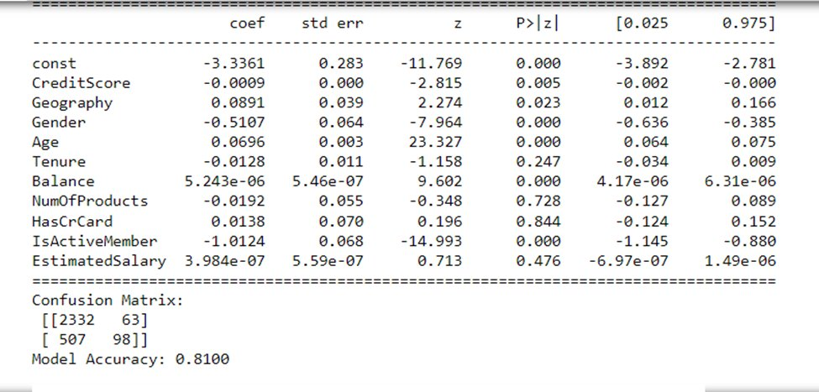

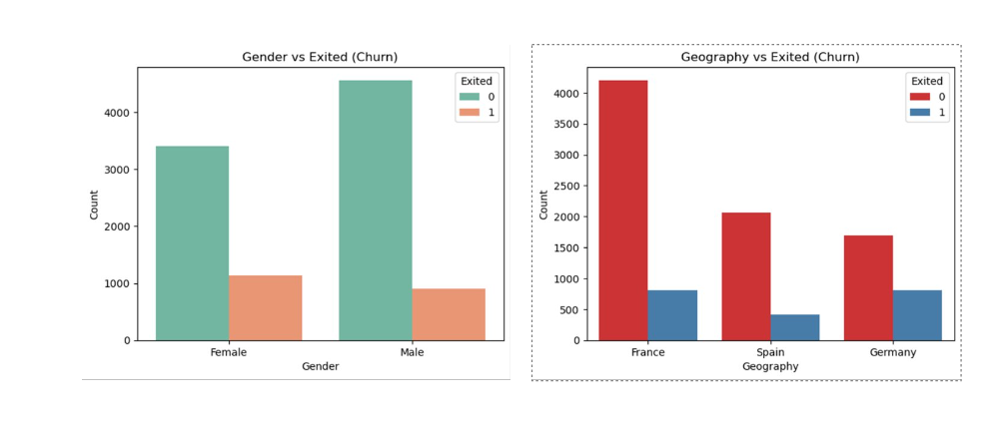
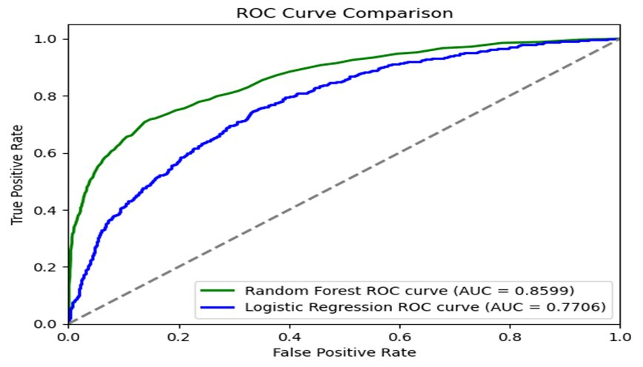
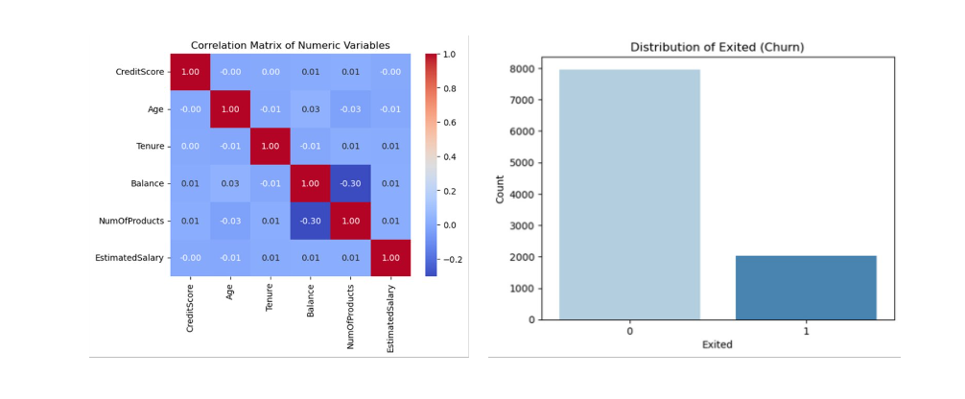
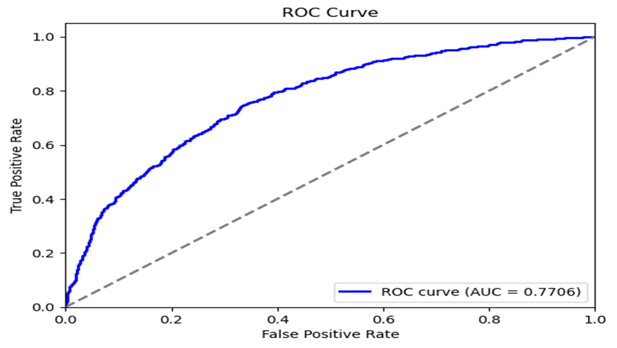
Predicting Customer Churn in Banking Using Machine Learning: A Comparative Analysis of Logistic Regression and Random Forest Models
Student:
Analytics Capstone Project, Pace University
Introduction
EDA Visuals
Logistic Regression Results
Random Forest reults
Customer churn impacts profitability, and reducing churn by 5% can increase profits by 25%-95%.
The project aims to build a predictive model for customer churn using machine learning.
Logistic Regression and Random Forest are chosen for their interpretability and predictive power.
The goal is to improve retention strategies by identifying at-risk customers.
Auc Curve Comparison
Methodology
Data from Kaggle covers demographics and engagement details of bank customers.
Data preprocessing includes cleaning, encoding, and scaling for model stability.
Feature engineering selects key predictors using RFE and PCA techniques.
Evaluation metrics: precision, recall, F1 score, and AUC-ROC.
Logistic Regression AUC Curve
Conclusion and Discussions
The study confirms machine learning's role in predicting customer churn.
Random Forest proved more accurate for complex datasets.
Strategies like engaging older customers can reduce churn rates.
Machine learning can proactively manage churn and enhance customer retention
EDA Analysis
Logistic Regression
EDA shows that variables like credit score, balance, and age are key churn indicators.
Geographic and demographic variables reveal location-based patterns in churn.
Correlation analysis highlights complex dependencies between variables.
Churn distribution shows an 80% non-churn and 20% churn ratio.
Achieved an accuracy of 81%, showing a fair fit for binary prediction.​
Coefficients:​
Age: 0.0696, indicating older customers are more likely to churn.​
Balance: 5.243e-06, suggesting higher balances are associated with increased churn.​
IsActiveMember: -1.0124, showing that active members are less likely to churn.​
CreditScore: -0.0009, slightly reducing churn likelihood with higher scores.​
Gender and credit card ownership have minimal impact on churn in this model.​
AUC score of 0.77 suggests moderate discriminatory power.
Random Forest
•Achieved higher accuracy at 86.6%, outperforming Logistic Regression.​
•Reduced false negatives, identifying at-risk customers more effectively.​
•Handles complex, non-linear patterns in customer churn data.​
•Provides insights into important predictors for churn.
References
• Ahmed, F., & Maheswari, D. U. (2020). Comparative analysis of machine learning algorithms for customer churn prediction. International Journal of Advanced Science and Technology, 29(3), 3543-3555.
• Ali, Z., Fatima, S., & Ahmed, M. (2022). Predicting customer churn in the telecom sector using machine learning. International Journal of Advanced Research in Computer Science, 13(2), 45-51.
• Burez, J., & Van den Poel, D. (2009). Handling class imbalance in customer churn prediction. Expert Systems with Applications, 36(3), 4626-4636.
RESEARCH POSTER PRESENTATION TEMPLATE © 2019
www.PosterPresentations.com

